Slide 1
Financial Overview
NOVEMBER 07, 2023

Slide 2
Financial Analysis.
Profits are up, and losses are down! We are very proud of the progress our team has made. Today we’ll review our wins and losses from last year and give you an overview of what you can expect for next year.

Slide 3
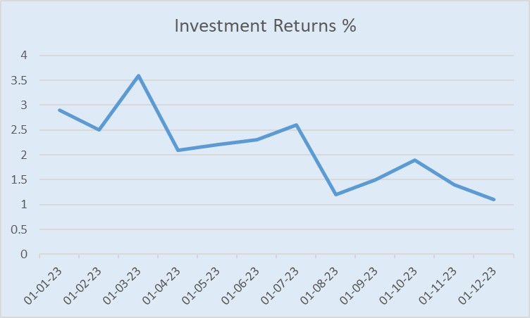
Growth by sector chart

Slide 4
Summary
Keeping The Financial Insights In Mind We Can See That The Company Has Seen Some Great & Notable Changes In the several Past Months for example the company has seen great improvement in the month of MARCH. The Company Has also seen some bad days in the month of AUGEST. The Company Must improve their focus on their Financial Insights.

